Slide 1
Dev Center Developer’s Guide to Windows 10
Shen Chauhan Andy Wigley
@shenchauhan @andy_wigley

Slide 2
Agenda
Migration for existing apps
Package Management
Distribution
Hardware filtering
In app purchases and discounts
In app advertisements
Promotions
Beta Testing
Campaigns
Analytics
Business Store
…

Slide 3
Migration for existing apps

Slide 4

One Store for one Windows
Windows Desktop
Windows Mobile
ONE CORE OS
ONE APP PLATFORM
ONE STORE
Windows 10
Xbox
IoT
HoloLens
Surface Hub

Slide 5
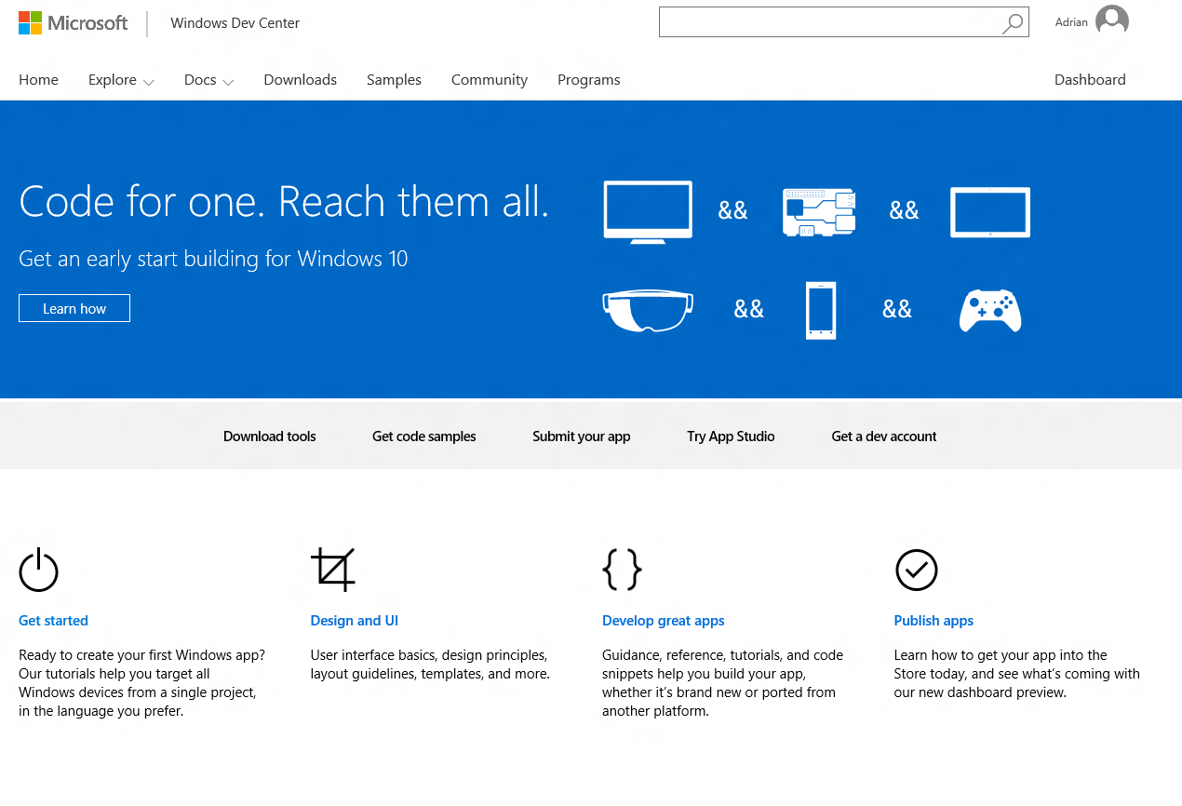
One Dev Center
One destination for supporting all Windows devices
One registration
One app submission
Customer acquisition
Customer engagement
Powerful monetization
Rich analytics
One payout
DEV.WINDOWS.COM

Slide 6
The path to convergence
2013
Two consumer experiences
Two developer experiences

Slide 7

The path to convergence
2013
2014
Two consumer experiences
Two developer experiences
One consumer experience,
enabled by linked apps
Two developer experiences,
loosely connected

Slide 8
The path to convergence
2013
2014
2015
Two consumer experiences
Two developer experiences
One consumer experience,
enabled by linked apps
Two developer experiences,
loosely connected
One developer experience

Slide 9



Merging linked apps and IAP
Application
IAPs
Packages
.xap, .appx, .appxbundle
Pricing
Store listings
IAP 1
Pricing / Listing
IAP 2
Pricing / Listing
Application
IAPs
Application
IAP 3
Pricing / Listing
Packages
(7.1/8.0/8.1)
Pricing
Store listings
IAP 1
Packages
(8.0/8.1)
Pricing
Store
listings
IAP 2
IAP 2
IAP 3

Slide 10

Merging details
Windows Phone
Windows
Application
Base Price
Markets
Description
Category
Market Prices
Screenshots
Application
Application
Screenshots
Base Price
Markets
Description
Category
Base Price
Markets
Description
Category
Market Prices
Screenshots
Screenshots

Slide 11
.NET Native compilation
50% faster average startup time
14% less average memory usage

Slide 12
To the Dev Center

Slide 13
Package filters

Slide 14
Supporting different devices
Runtime adaptation typically gives your customers the best experience

Slide 15
Windows 10 packages
A package is applicable to a device if the device satisfies all the declared dependencies
Device family
Universal, Desktop, Mobile, Xbox, Team, Holographic
Can precisely specify required minimum device family version
Processor architecture
ARM, x86, x64, Neutral
Foreground memory [optional]
Amount of memory your app can use while it is running in the foreground
300MB, 750MB, 1000MB, 2000MB
DirectX [optional]
Combination of DirectX API version and DirectX hardware feature level

Slide 16
Package selection
Customers think in terms of apps: They don’t see individual packages
Store automatically chooses the best (highest-versioned) applicable package for a device
Store will try all the packages currently published for your app until we find a match
v1.9.0.0
Windows 10 Universal or better
Works with any processor
v1.6.0.0
Windows 10 Universal or better
Works with any processor
v1.4.2.0
Windows Phone 8.1 or better
Requires 300MB of memory while running
v1.8.4.0
Windows Desktop 10.0.11001.0 or better
Works with any processor
Requires DirectX 12 APIs and DXFL 12_0 or better

Slide 17
Package selection
v1.9.0.0
Windows 10 Universal or better
Works with any processor
v1.6.0.0
Windows 10 Universal or better
Works with any processor
v1.4.2.0
Windows Phone 8.1 or better
Requires 300MB of memory while running
v1.8.4.0
Windows Desktop 10.0.11001.0 or better
Works with any processor
Requires DirectX 12 APIs and DXFL 12_0 or better
v1.9.0.0
Windows 10 Universal or better
Works with any processor
v1.6.0.0
Windows 10 Universal or better
Works with any processor
v1.4.2.0
Windows Phone 8.1 or better
Requires 300MB of memory while running
v1.8.4.0
Windows Desktop 10.0.11001.0 or better
Works with any processor
Requires DirectX 12 APIs and DXFL 12_0 or better
Gaming desktop
Desktop Device Family
Windows 10.0.11041.0
DXFL 12_0

Slide 18
Package selection
v1.9.0.0
Windows 10 Universal or better
Works with any processor
v1.6.0.0
Windows 10 Universal or better
Works with any processor
v1.4.2.0
Windows Phone 8.1 or better
Requires 300MB of memory while running
v1.8.4.0
Windows Desktop 10.0.11001.0 or better
Works with any processor
Requires DirectX 12 APIs and DXFL 12_0 or better
v1.9.0.0
Windows 10 Universal or better
Works with any processor
v1.6.0.0
Windows 10 Universal or better
Works with any processor
v1.4.2.0
Windows Phone 8.1 or better
Requires 300MB of memory while running
v1.8.4.0
Windows Desktop 10.0.11001.0 or better
Works with any processor
Requires DirectX 12 APIs and DXFL 12_0 or better
Device | Package given
Gaming desktop | v1.9.0.0
Older laptop
Desktop
Windows 10.0.12473.0
x86 processor
DXFL 11_0

Slide 19
Package selection
v1.9.0.0
Windows 10 Universal or better
Works with any processor
v1.6.0.0
Windows 10 Universal or better
Works with any processor
v1.4.2.0
Windows Phone 8.1 or better
Requires 300MB of memory while running
v1.8.4.0
Windows Desktop 10.0.11001.0 or better
Works with any processor
Requires DirectX 12 APIs and DXFL 12_0 or better
v1.9.0.0
Windows 10 Universal or better
Works with any processor
v1.6.0.0
Windows 10 Universal or better
Works with any processor
v1.4.2.0
Windows Phone 8.1 or better
Requires 300MB of memory while running
v1.8.4.0
Windows Desktop 10.0.11001.0 or better
Works with any processor
Requires DirectX 12 APIs and DXFL 12_0 or better
Device | Package given
Gaming desktop | v1.9.0.0
Older laptop | v1.8.4.0
Value phone
Windows 10 Mobile
190MB foreground memory

Slide 20
Package selection
v1.9.0.0
Windows 10 Universal or better
Works with any processor
v1.6.0.0
Windows 10 Universal or better
Works with any processor
v1.4.2.0
Windows Phone 8.1 or better
Requires 300MB of memory while running
v1.8.4.0
Windows Desktop 10.0.11001.0 or better
Works with any processor
Requires DirectX 12 APIs and DXFL 12_0 or better
Device | Package given
Gaming desktop | v1.9.0.0
Older laptop | v1.8.4.0
Value phone | v1.4.2.0

Slide 21
The Business Store

Slide 22
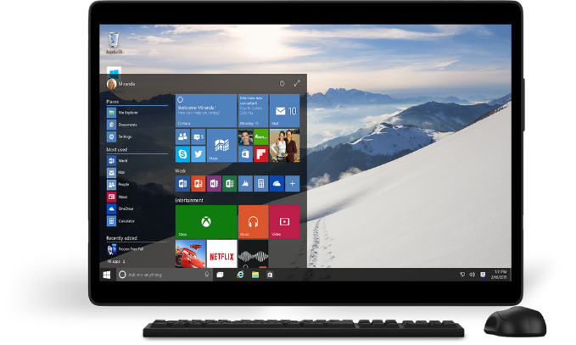
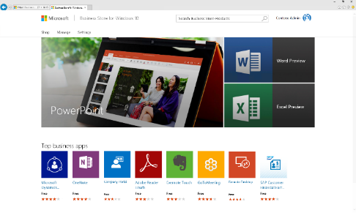
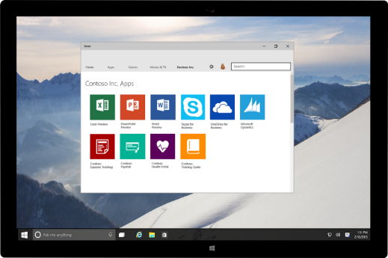
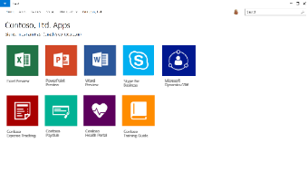
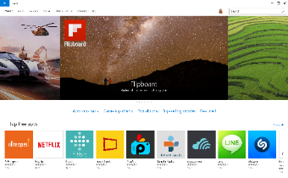

New for Windows 10: Business Store
Extend your reach in volume leveraging the platform and tools you use today
Extend your reach to organization in volume
Reach businesses of all sizes with your existing apps
Submit private/customized apps
No additional overhead
One submission flow, same as consumer
Use Dev Center dashboard to manage and track all apps
Seamless for organizations and end-users
Solution to discover, acquire, manage and distribute apps in volume
Users install across Windows 10 devices
Get Started today
Dev Center opens for Windows 10 app submissions on 7/29

Slide 23
Business Store App Workflow
1
2
ISV logs into Windows Dev Center and submits app
App available in consumer Store
Windows Dev center
1a
IT Developer or ISV may choose to publish to organizations (authorization required)
Business
store
2
App also available in
Business Store for IT Purchaser
2a
App published directly to organization’s inventory
4
Apps deployed to organizational users via method chosen by IT Purchaser
3
Apps acquired by IT Purchaser
added to organization's inventory

Slide 24
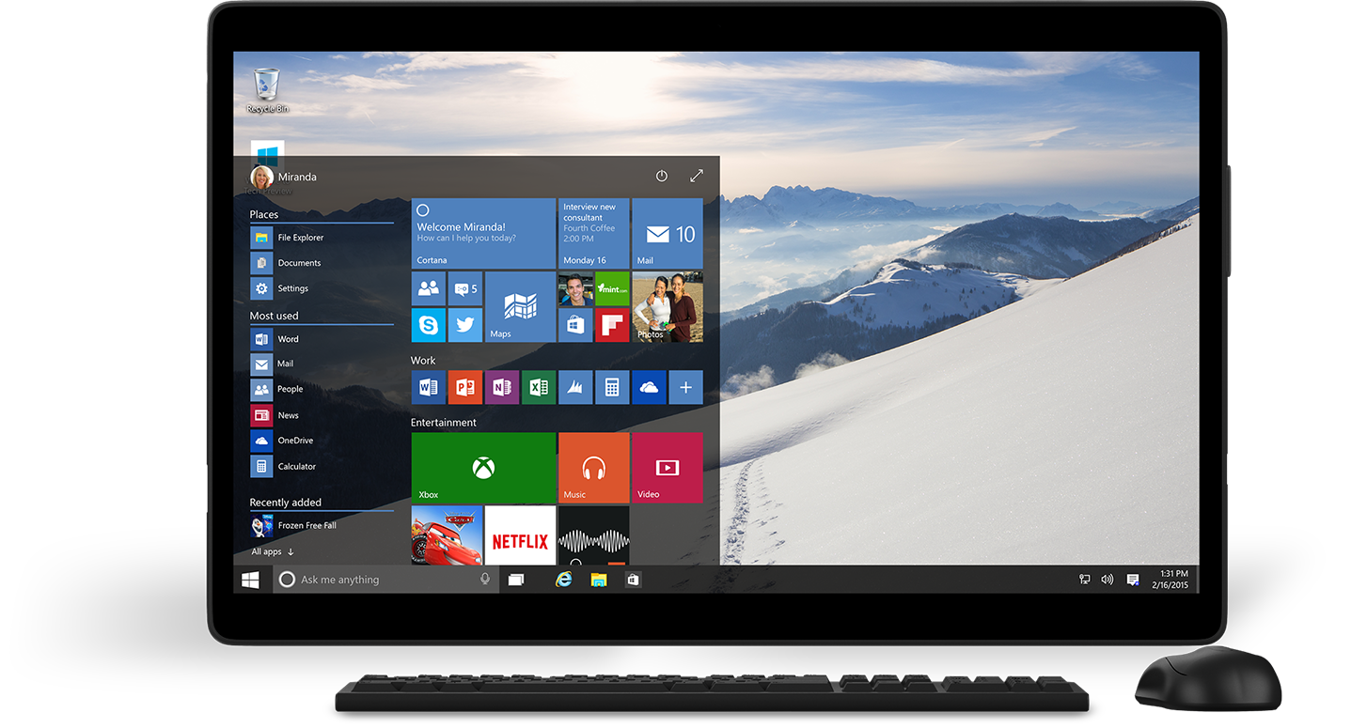

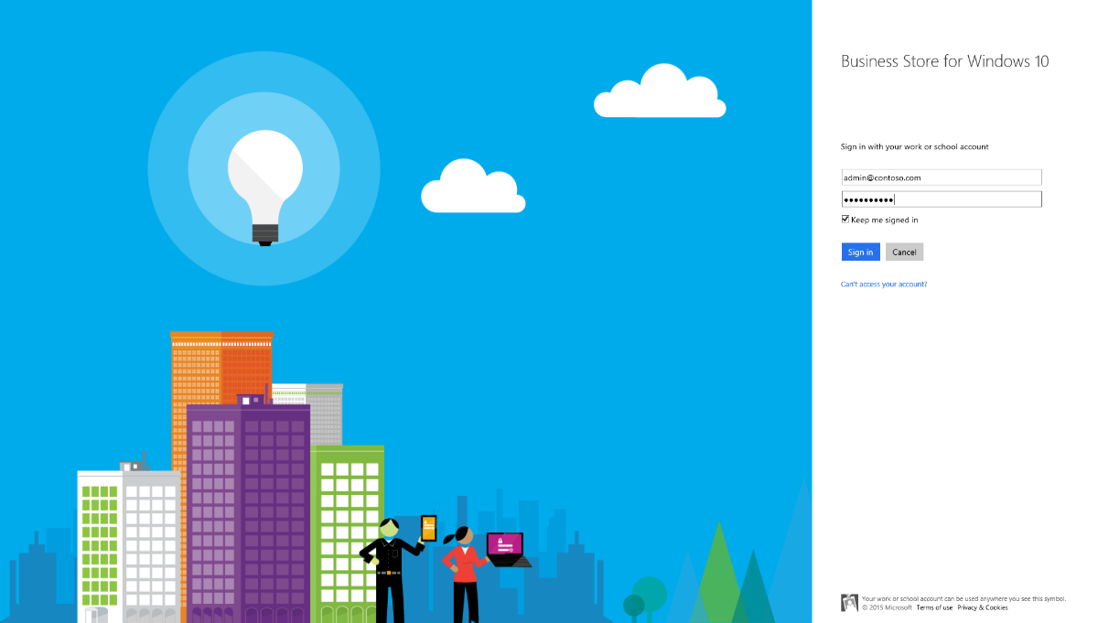

Slide 26
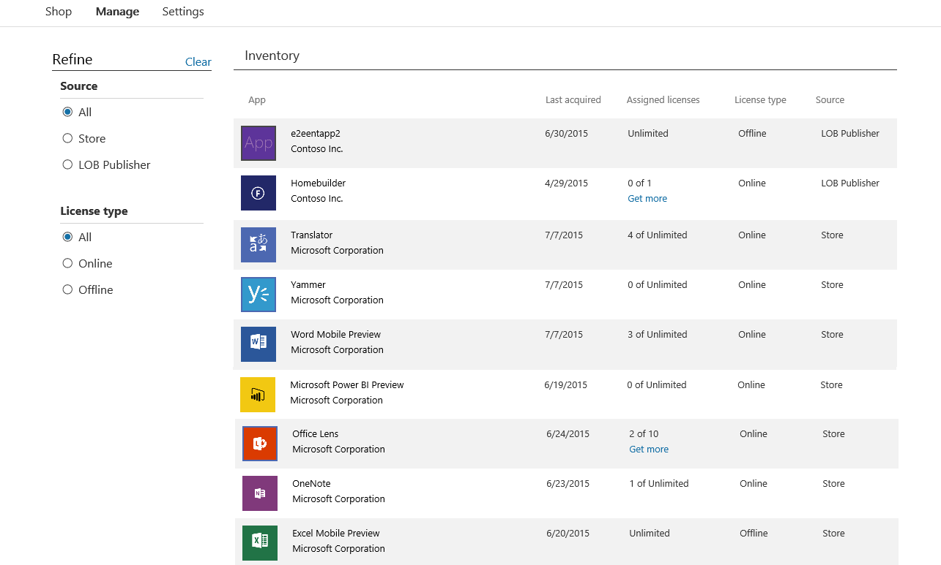

Slide 27

